Slide 1

Domain Name System (DNS) at the Application Layer

Slide 2
INTRODUCTION
Internet Computers always identify each other with unique numbers called IP addresses.
But how they load a website when we type its address in the web browser's URL bar that's the place. where DNS comes in.
What is DNS?
DNS operates at Layer 7, providing essential name resolution services to all Internet applications
Example: When you type www.google.com, DNS translates it to 142.250.190.14 behind the scenes.
Human readable address to machine readable.

Slide 3
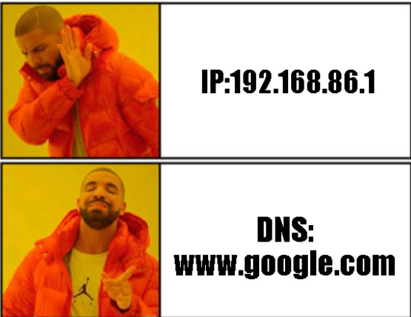






Why DNS is Essential ?
Human-Friendly
Humans remember names easily, while computers operate with numerical IP addresses
Scalability
Flexibility
Supports billions of domain names across a distributed global infrastructure
IP addresses can change without affecting the domain name users rely on
DNS functions as the phonebook of the Internet, making web navigation intuitive and accessible for everyone.

Slide 4
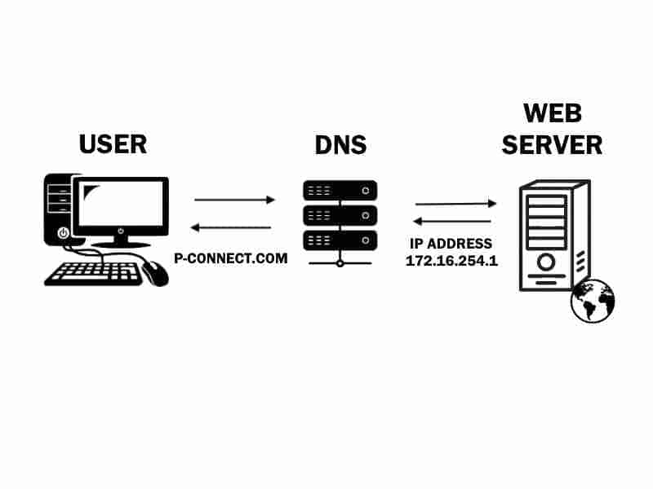
How does DNS work?
DNS is the phone book of the Internet
It converts website names into IP addresses
You type www.example.com
Browser needs the IP address (like finding a phone number)
DNS process (behind the scenes):
Browser asks a DNS resolver
Resolver checks DNS servers
Gets the correct IP address
Browser uses the IP address to load the website
Key point: DNS works automatically and makes websites easy to access
Resolver

Slide 5

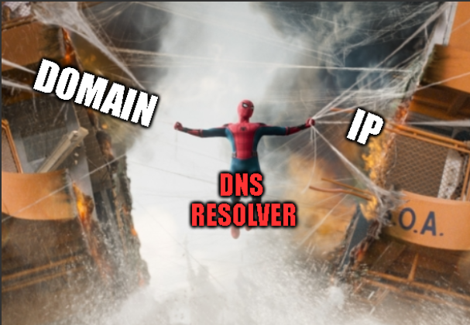
DNS resolver
DNS Resolver (Recursive Resolver)
First stop in the DNS lookup process
Receives request from the DNS client (web browser)
Function:
Converts URL into an IP address
Contacts other DNS servers to get the answer
DNS Query Types:
Recursive Query: Client asks for final IP address
Iterative Query: Resolver asks DNS servers step by step
Key Difference:
Recursive query → request
Recursive resolver → server handling the request
Flow:
DNS Client → DNS Recursive Resolver → DNS Servers

Slide 6





DNS Hierarchy Structure
Root
Top-Level Domains
Dot at top of DNS tree
.com .org .edu and others
.
Second-Level Domains
Subdomains
Example: mail.google.com
Example: google.com
DNS follows a tree-like hierarchical structure that starts at the root and branches down through increasingly specific domain levels. This organization enables efficient query routing and distributed management of the global domain name space.
Why Hierarchy Matters
Root Level (.) — The foundation of all DNS queries
TLDs — Categories like .com, .org, .edu, .gov
Second-Level — Organization names like google.com
Subdomains — Specific services like mail.google.com
The hierarchical design allows DNS to scale globally while distributing administrative responsibility across millions of organizations and domain owners.

Slide 7




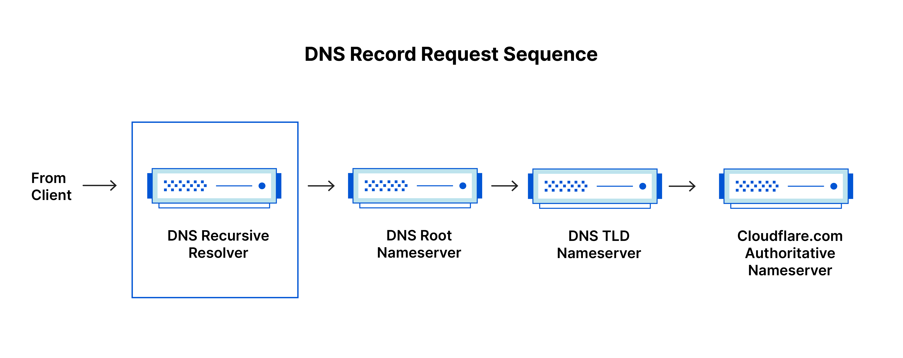
DNS servers involved in loading a webpage:
Recursive Resolver
Root Name Servers
Receives request from the browser.
First step in DNS lookup. It redirect the request to the
correct TLD server. which one .org or gov
Top Level DomainTLD Servers
Authoritative Servers
Manage top-level domains like e.g., .com, .org and direct queries to authoritative servers which abc.com
Provide definitive answers for specific
domain names they are responsible for managing

Slide 8
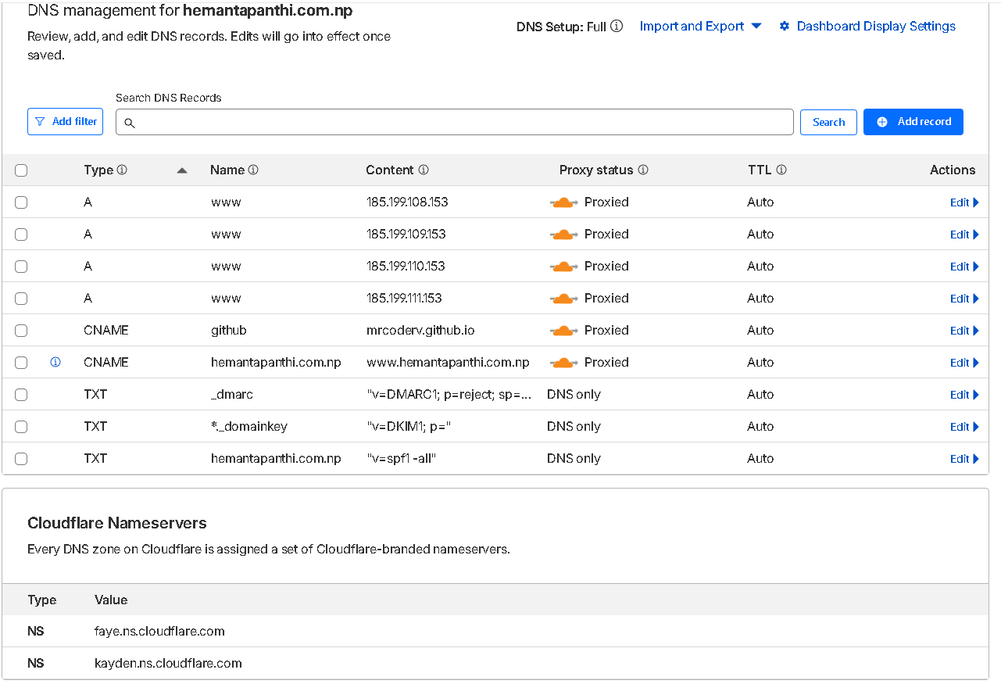
Common DNS Resource Records
A Record (IPv4) : Maps a domain name to its corresponding IPv4 address for routing
CNAME Record (Aliases):Creates an alias pointing one domain name to another domain.
www.example.com → example.com
NS Record (Name Servers): Indicates the authoritative name servers for a domain.
(np domain provider ←→cloudfair )
AAAA Record (IPv6):
Maps a domain name to its IPv6 address for next-gen internet.
MX Record (Mail Servers): Specifies the mail servers responsible for handling emails.
example.com → mail.example.com

Slide 9

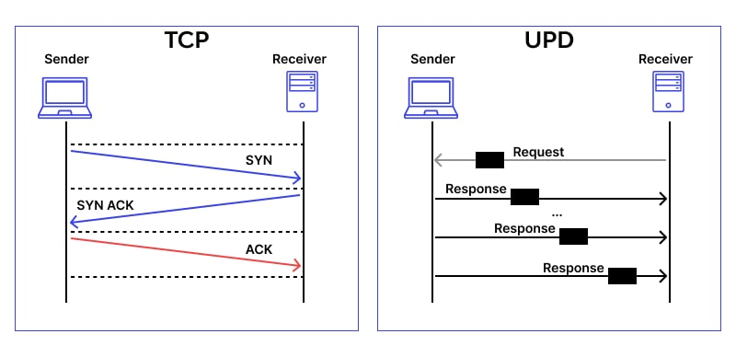

Transport Protocols Used by DNS
UDP Port 53
Primary protocol for standard DNS queries
Fast and lightweight
Connectionless communication
Efficient for small query/response exchanges
Preferred for speed and minimal overhead
TCP Port 53
Alternative protocol for special cases
Used when responses exceed 512 bytes
Required for zone transfers between DNS servers
Provides reliable, connection-oriented delivery
Ensures complete data transmission

Slide 10

DNS Security Challenges
DNS Spoofing / Cache Poisoning:
Fake DNS records are inserted,
Users are redirected to malicious websites
DDoS Attacks on DNS:
DNS servers are flooded with traffic,
Causes service disruption and slow or failed access
Man-in-the-Middle (MITM) Attack:
Attacker intercepts DNS queries
Can redirect traffic or steal information

Slide 11
Thanku

